Slide 1
ECE 506 Final Project
Members: Alex Beaulier and Ryan O’dea
Advisor: Roy Kravitz

Slide 2
Summary
Telerobotics Overview
Microcontroller | Communication Development
Unity Development
Demo
Future Development

Slide 3
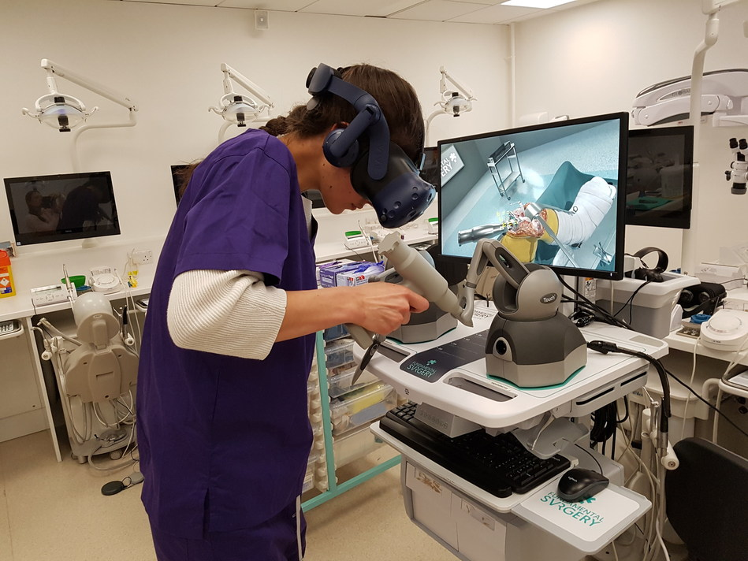
Telerobotics Overview
VR control platform has been matured
Various industries could be “on demand”
Current implementations are health care
Future implementations more generic

Slide 4

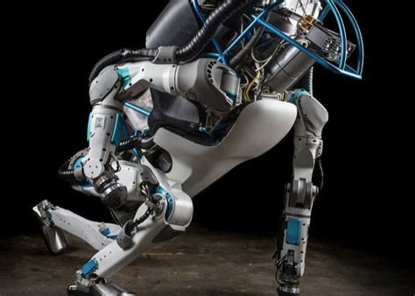
Telerobotics Future
Workers could be anywhere
Possible Ideas
Yard Work
Household Chores
Janitorial
Construction
Factories
Security
Military
Underwater Welding Oil Rigs
AI/ML from human guided robots over time

Slide 5
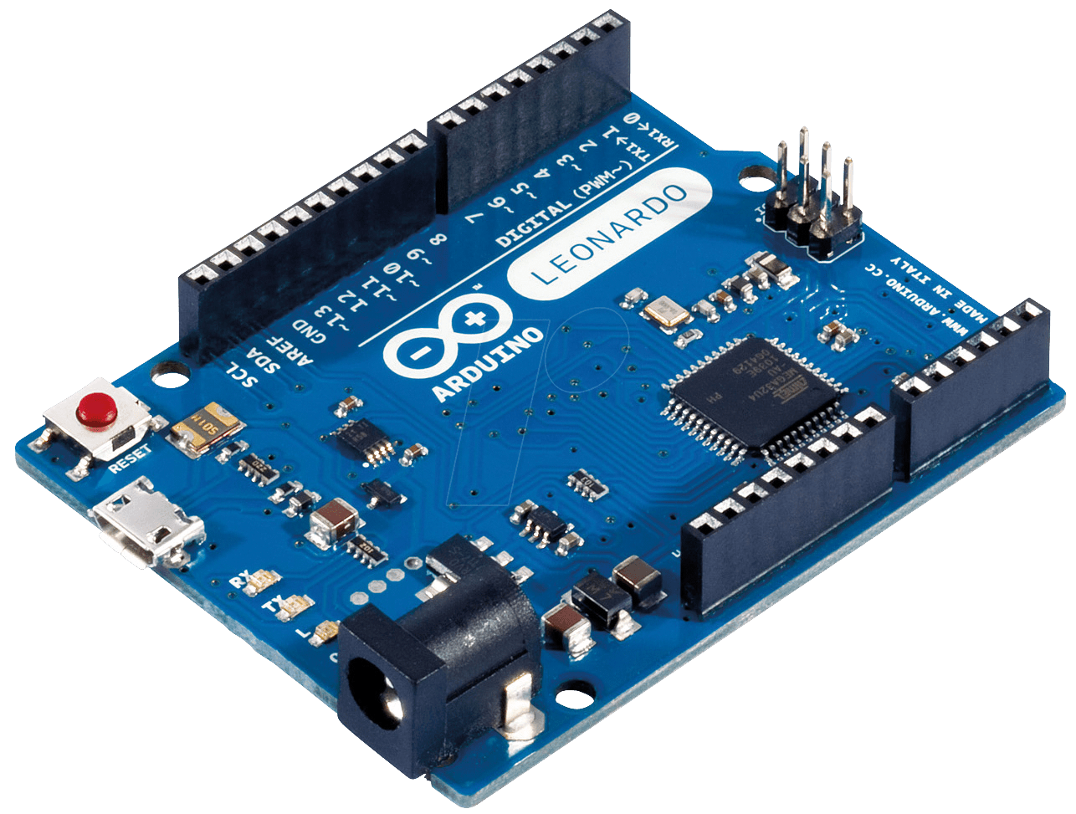
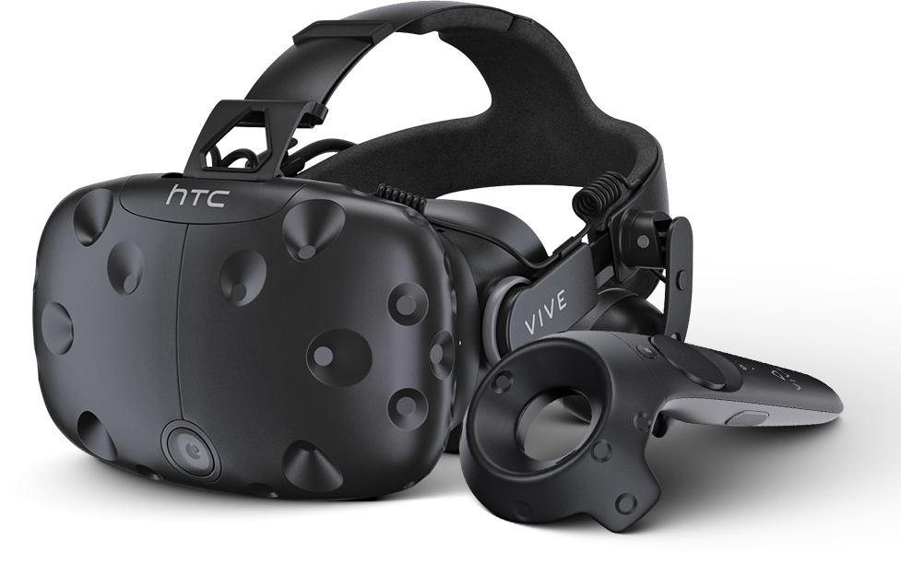
Telerobotics Overview
What does an operator need?
Basic communication
Microcontrollers for actuation, signaling LEDs ect
Vision System for operator line of sight
Emergency Signals
Guaranteed signal communication to stop
VR headset for precision movement
Game engine
Robust controls systems with fine tuning movements

Slide 6
Communication Development
Serial Sockets
Camera Systems
Video Transmission Protocols

Slide 7
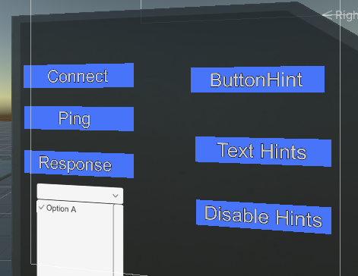
Serial Sockets – USB

Slide 8
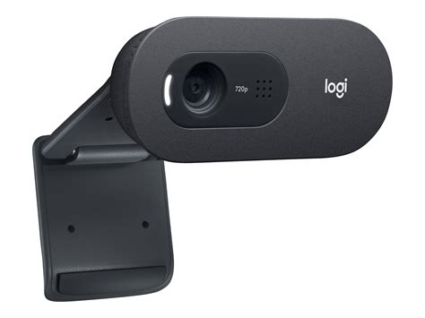
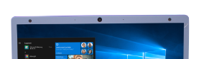
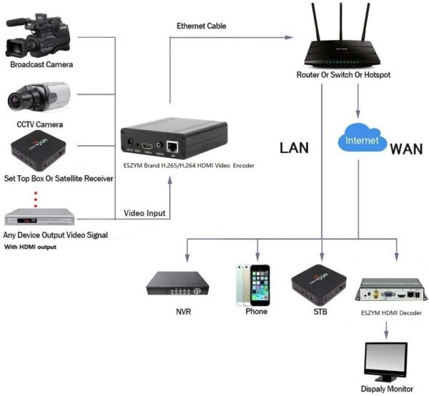
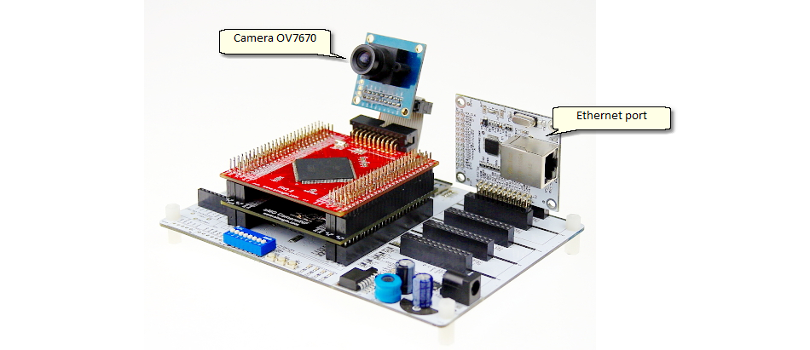
Camera Systems
RPBI, Logitech and integrated Laptop Camera
Video Transmission Protocols
Developed tools for Unity

Slide 9
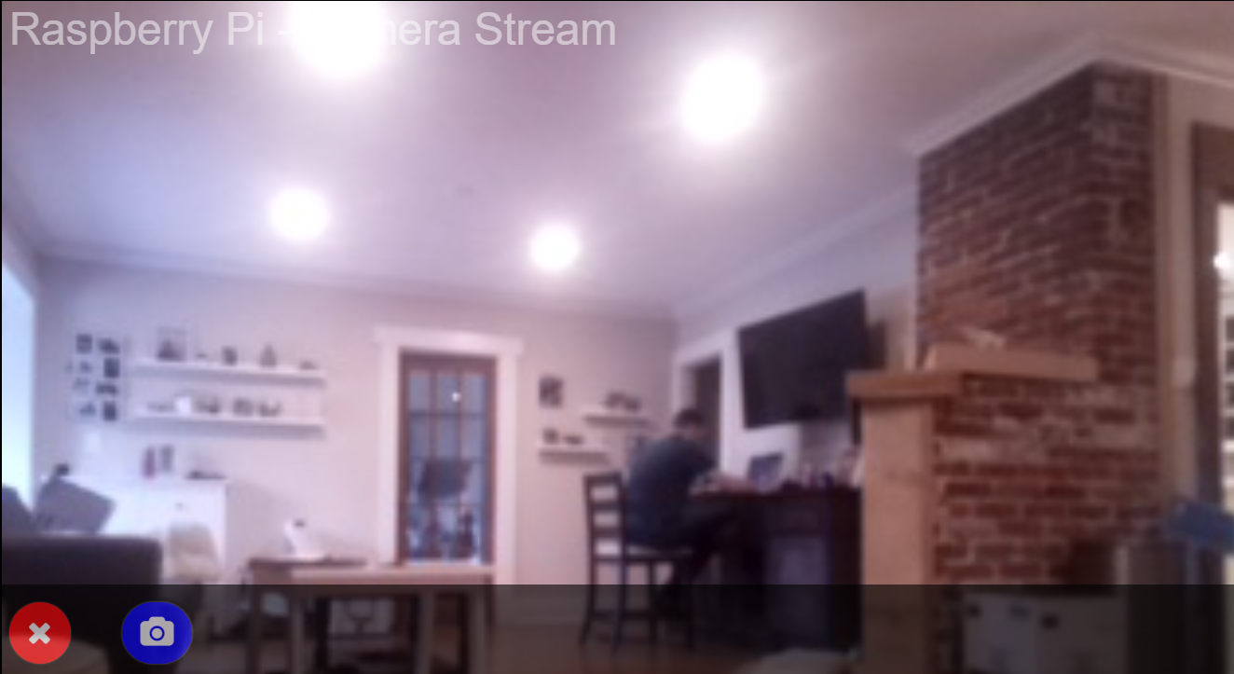
Camera Systems
Achieved local remote server
Need to explore external access and authorized certificate authority (TLS)
Still require WebRTC Unity(Audio + commands + low latency)

Slide 10
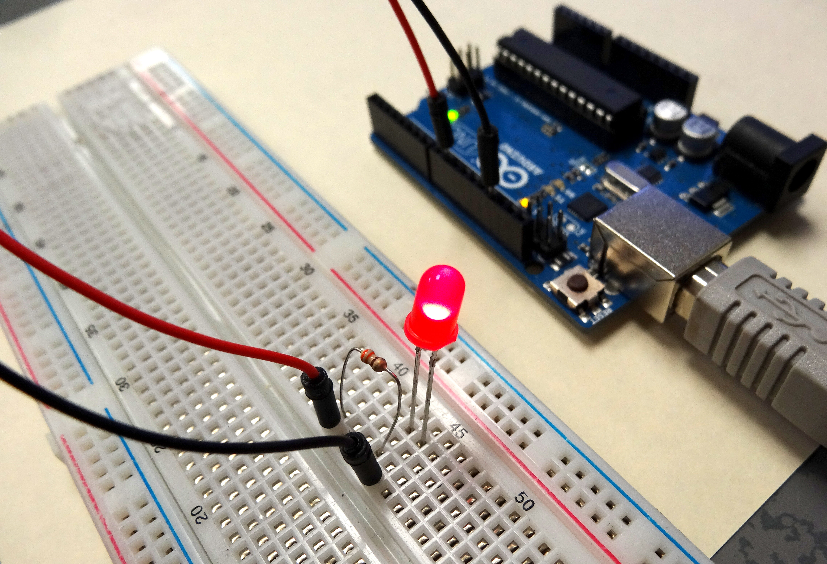
Unity Development
LED
Web Camera
Buttons

Slide 11
Demo

Slide 12
Future Development
WebRTC – Video and generic commands (not incl. TCP/IP based for E-Stops)
Discussion with Gerald Melles from Germany on Gstreamer master’s thesis within Unity
TCP/IP Sockets or MQTT Server for Emergency Signals
Need to provide robust signaling that has to be delivered to target along with signal loss detection
IEEE Paper – Submit to design conference for telerobotics topic

Slide 13
Future Development
Huge business potential and great margins on investments
Worldwide workforce and could assist with nighttime operations
Significantly improved safety

Slide 14
Questions?
Contact Ajbeaulier@gmail.com for inquiries
Github Link

